Slide 1


SHIELD INSURANCE
PRESENTED BY DEVENDER
PROVIDED BY – CODEBASICS

Slide 2
COMPANY OVERVIEW
Shield Insurance is an insurance provider in the insurance industry.
The company provides the policies to the customers for their uncertainty and the expense of health issues to protect their financial stability.
Shield insurance policies can reduce customers' burdens and worries.

Slide 3
The objective of the project is to analyze the customer growth, revenue, and its growth rates. And month-over-month customer , revenue growth, as well as understand the policy impact of age groups on business. And to analyze the revenue through different sales mode.
OBJECTIVE

Slide 4
Operation cities
CITIES
CHENNAI
DELHI
HYDERABAD
INDORE
MUMBAI

Slide 5
Operation Timeline
FEB 2023
MAR 2023
APR 2023
JAN 2023
DEC 2022
NOV 2022

Slide 6
Sales Mode
OFFLINE - AGENT
SALES MODE
ONLINE - WEBSITE
OFFLINE- DIRECT
ONLINE - APP

Slide 7
Policies
policy_id | base_coverage_amt(INR) | base_premium_amt(INR)
POL4321HEL | 200000 | 5000
POL4331HEL | 300000 | 7500
POL3309HEL | 500000 | 12000
POL5319HEL | 750000 | 16700
POL6303HEL | 1000000 | 21500
POL6093HEL | 1500000 | 31700
POL9221HEL | 2500000 | 42500
POL1048HEL | 5000000 | 76500
POL2005HEL | 10000000 | 120000

Slide 8
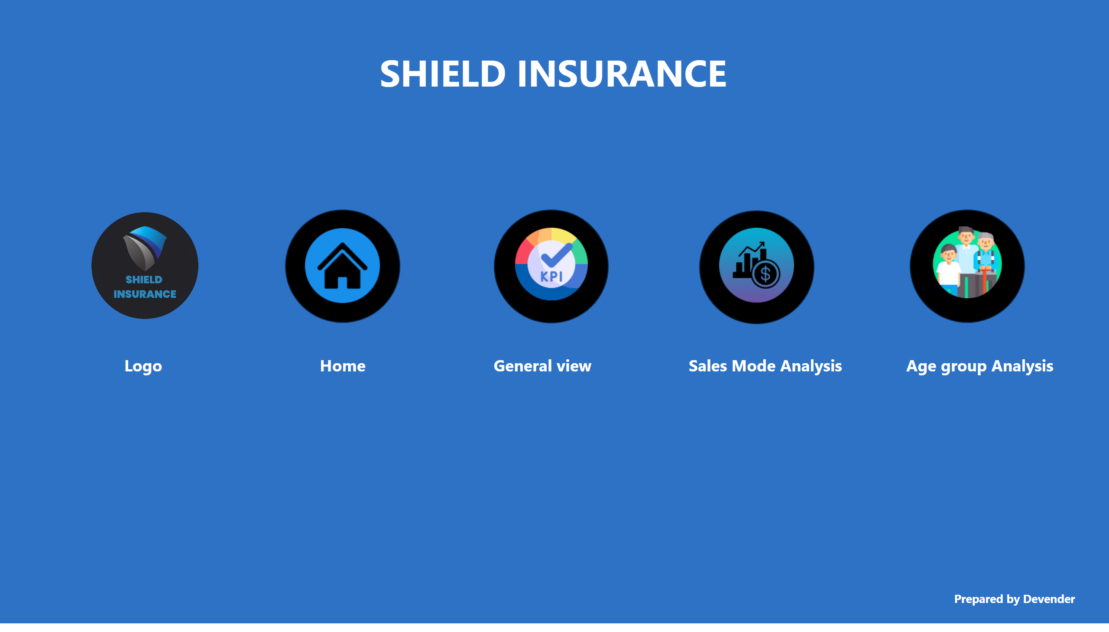
Home
Notes:
image
No alt text provided
image
No alt text provided
shape
No alt text provided
image
No alt text provided
shape
No alt text provided
image
No alt text provided
shape
No alt text provided
image
No alt text provided
shape
No alt text provided
textbox
No alt text provided
textbox
No alt text provided
textbox
No alt text provided
textbox
No alt text provided
textbox
No alt text provided
textbox
No alt text provided
textbox
No alt text provided

Slide 9
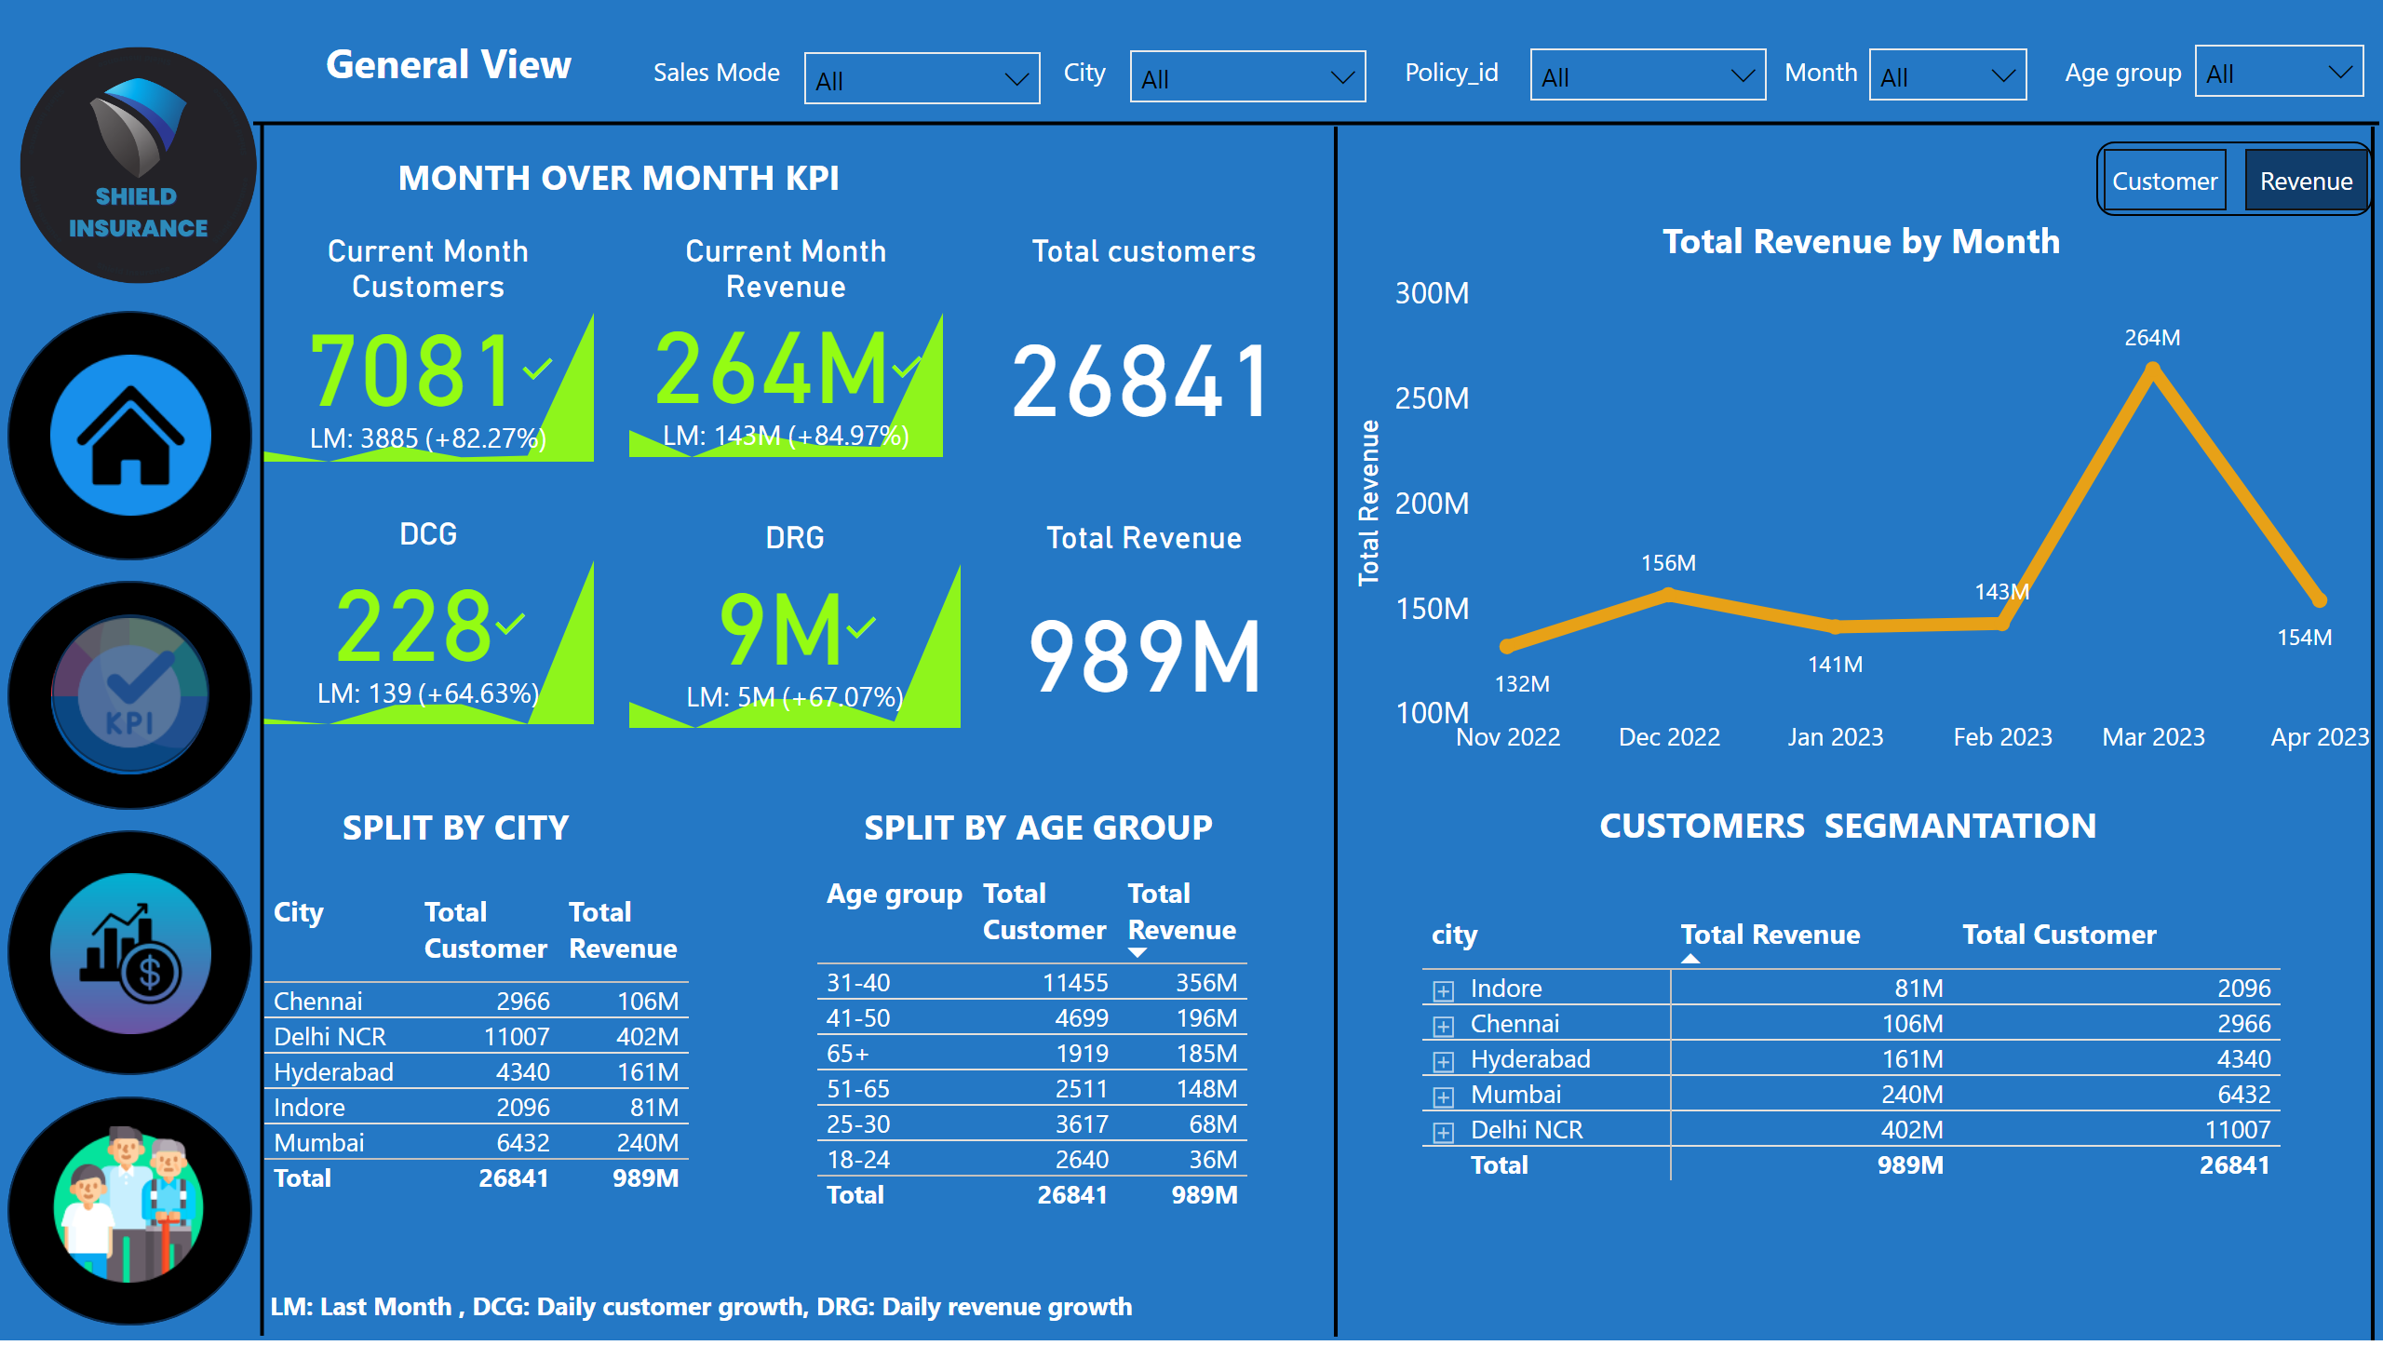
General View
Notes:
Current Month Customers
No alt text provided
Current Month Revenue
No alt text provided
DCG
No alt text provided
DRG
No alt text provided
image
No alt text provided
image
No alt text provided
shape
No alt text provided
shape
No alt text provided
image
No alt text provided
shape
No alt text provided
image
No alt text provided
shape
No alt text provided
KPI
No alt text provided
Total Revenue by Month
No alt text provided
lineChart
No alt text provided
card
No alt text provided
tableEx
No alt text provided
tableEx
No alt text provided
pivotTable
No alt text provided
bookmarkNavigator
No alt text provided
textbox
No alt text provided
slicer
No alt text provided
textbox
No alt text provided
slicer
No alt text provided
textbox
No alt text provided
slicer
No alt text provided
textbox
No alt text provided
slicer
No alt text provided
textbox
No alt text provided
slicer
No alt text provided
textbox
No alt text provided
shape
No alt text provided
shape
No alt text provided
shape
No alt text provided
shape
No alt text provided
textbox
No alt text provided
shape
No alt text provided
textbox
No alt text provided
textbox
No alt text provided
textbox
No alt text provided
Total customers
No alt text provided
textbox
No alt text provided
Total Revenue
No alt text provided

Slide 10
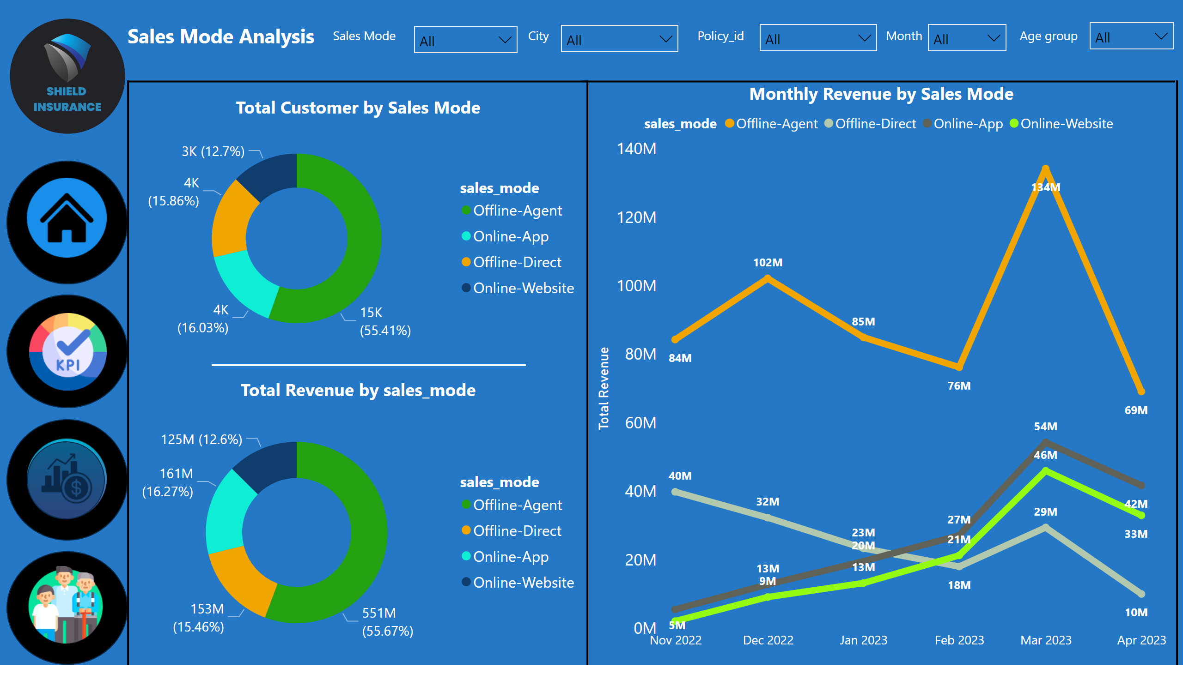
Sales ModeAnalysis
Notes:
image
No alt text provided
image
No alt text provided
shape
No alt text provided
image
No alt text provided
shape
No alt text provided
image
No alt text provided
shape
No alt text provided
image
No alt text provided
shape
No alt text provided
slicer
No alt text provided
slicer
No alt text provided
slicer
No alt text provided
slicer
No alt text provided
slicer
No alt text provided
textbox
No alt text provided
textbox
No alt text provided
textbox
No alt text provided
textbox
No alt text provided
textbox
No alt text provided
textbox
No alt text provided
shape
No alt text provided
shape
No alt text provided
shape
No alt text provided
shape
No alt text provided
shape
No alt text provided
shape
No alt text provided
Monthly Revenue by Sales Mode
No alt text provided
Total Customer by Sales Mode
No alt text provided
donutChart
No alt text provided
shape
No alt text provided

Slide 11
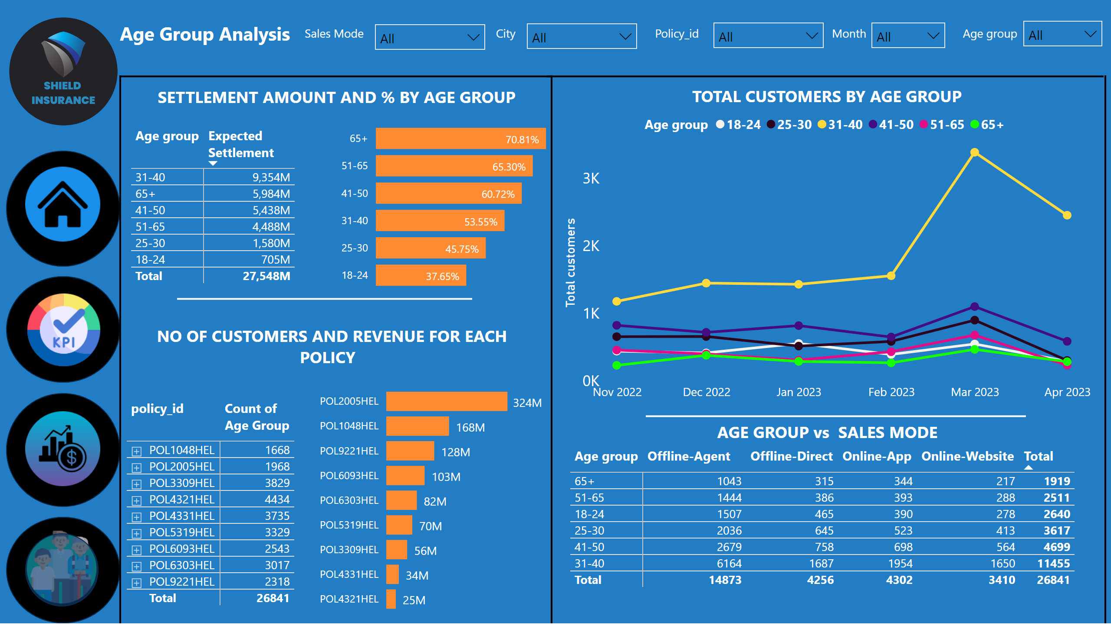
Age Group Analysis
Notes:
image
No alt text provided
image
No alt text provided
shape
No alt text provided
image
No alt text provided
shape
No alt text provided
image
No alt text provided
shape
No alt text provided
image
No alt text provided
shape
No alt text provided
slicer
No alt text provided
slicer
No alt text provided
slicer
No alt text provided
slicer
No alt text provided
slicer
No alt text provided
textbox
No alt text provided
textbox
No alt text provided
textbox
No alt text provided
textbox
No alt text provided
textbox
No alt text provided
textbox
No alt text provided
shape
No alt text provided
shape
No alt text provided
shape
No alt text provided
shape
No alt text provided
shape
No alt text provided
shape
No alt text provided
shape
No alt text provided
textbox
No alt text provided
textbox
No alt text provided
textbox
No alt text provided
shape
No alt text provided
TOTAL CUSTOMERS BY AGE GROUP
No alt text provided
Average settlement % by Age group
No alt text provided
pivotTable
No alt text provided
pivotTable
No alt text provided
clusteredBarChart
No alt text provided
pivotTable
No alt text provided

Slide 12
FINDINGS :
The insurance company has a customer base of 26,841.
The company has generated revenue of $989.3 million.
Delhi has the highest number of customers and revenue generated, with a total of 11,007 customers and 401.6 million in revenue, respectively.
The age group of 31–40 years has the highest number of customers, with a total of 11,455; it also contributes the highest revenue, generating a total of 356 million.
In the given data, the month of March had the highest customer base enrolled and generated the highest revenue.

Slide 13
FINDINGS :
The average expected settlement% is higher for the 65+ age group.
The majority of customers take the policies and pay premiums through the offline agent sales mode, with a share of 55.4% and 55.6% of revenue.
The policy ID "POL4321HEL" has a customer base of 4,434 because this is a base plan policy with coverage of 2 lakhs and a premium of 5000, so that is why this policy has a lower revenue of 25 million among all policies.
The policy ID "POL2005HEL" has the highest revenue of 324.3 million among all policies because this has the highest coverage of 1 crore and a premium of 120000, and this policy has a 1968 customer base.

Slide 14
THANK YOU

